Slide 1
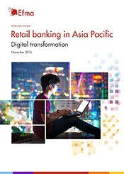
Retail Banking in Asia

Slide 2
Retail Banking in Asia
In other term retail banking can also be referred to as consumer banking. From McKinsey and Company, by 2020 Asia will go up to US$900 billion in retail banking revenue, growing at about 14% per yearly, becoming the second-largest wealth management region worldwide after the US

Slide 3
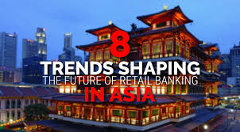
top trends factors finance professionals have to consider

Slide 4
top trends factors finance professionals have to consider
Shifting communication mediums
Rise of big tech disruption in financial services
Platform model

Slide 5
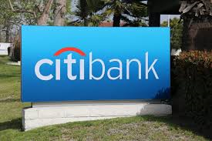
Citi on Treasury’s Real-Time Reality

Slide 6
Putting Change in Context
According to Chakravarti, there are several forces at work which impact businesses and the ways that treasurers and their teams manage cash, liquidity and foreign exchange. These forces are uncertainties over trade and changes in tax policies worldwide.

Slide 7
The Challenges
budgeting challenges
difficulty in getting the funding by the treasurer
, need of knowledge and skills on how cash managing are changing
the emergence of the technology that changes the business model
difficulty in prioritizing departmental transition by the treasurers.

Slide 8
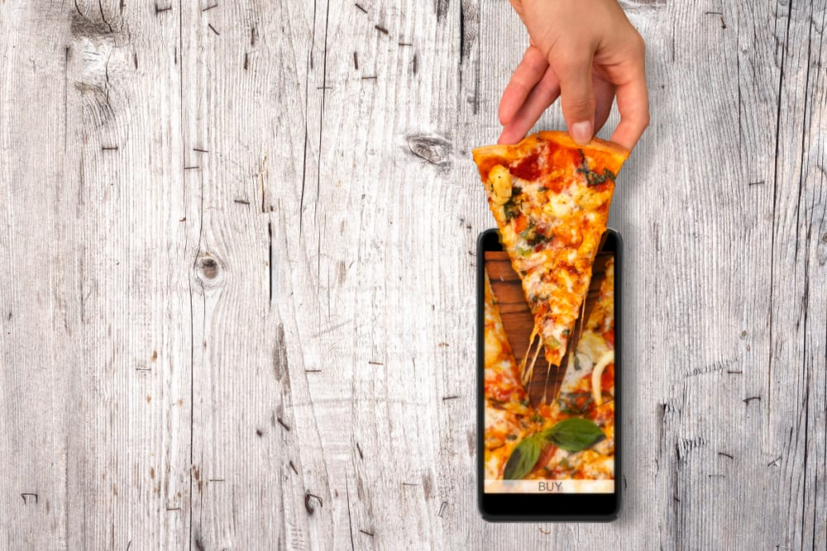
Mobile Smart Kitchens Reinvent Food Delivery

Slide 9

Curbing digital advertising’s big payments fraud problem

Slide 10
Other Citi on treasury’s real-time reality
invoice innovation that's on the roadmap of 75 per cent of AP professionals
what Brexit uncertainty will mean for Ireland’s FinServ future, Bitcoin Daily
: Indian Auto Manufacturer Calls for blockchain solutions; SEC accuses ICO incubator of violating securities laws

Slide 11
Other Citi on treasury’s real-time reality
Zuckerberg to visit DC to discuss Internet regulations
Alexa users can donate to 2020 election using Amazon Pay
the unmanned Drone delivers healthcare supplies to Island in Ireland

Slide 12
References
https://fintechnews.hk/8516/various/retail-banking-asia-trends/
https://www.pymnts.com/news/delivery/2019/drone-delivers-healthcare-supplies-to-ireland-island/

